Slide 1
Health Board Meeting 28th July 2021:
Overview of Progress against Annual Plan 2021/22 for Quarter 1

Slide 2
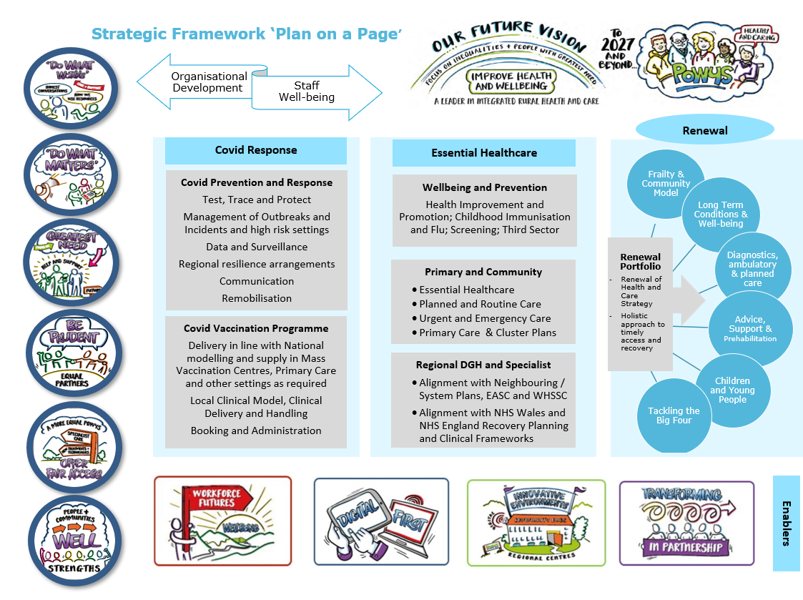
Strategic Annual Plan: ‘Plan on a Page’

Slide 3
COVID response
Covid-19 Prevention and Response Plan: The Health Board, working with partners in Public Health Wales and Local Authorities, will deliver a robust Test, Trace, Protect (TTP) programme in 2021/22.
Headlines: All Q1 actions delivered/on track
Highlights:
Prevention and Response Plan submitted to WG on 4th June 2021.
Testing workforce paper approved at PTHB Executive Committee 16.5.21 enabling workforce to be extended to end of March 2022.
Asymptomatic Testing Site operational 7th June 2021-4th July 2021 at Newtown.
Communication programme continues to be delivered, reviewed weekly through Prevention & Response Strategic Oversight Group
Timetable agreed for review of Civil Contingencies and Business Continuity plans in 2021/22.
Covid-19 Vaccination Programme: Delivery of the Mass Vaccination Programme to meet national milestones including ensuring all eligible adult population is offered a first dose by 31 July 2021.
Headlines: All Q1 actions delivered/on track
Highlights:
1. Vaccine Programme completed ahead of deadline. Powys has maintained the highest overall uptake of first doses and second doses throughout the campaign. Work on Autumn/Winter Booster Campaign on track.

Slide 4
Essential Healthcare
Well-being, Prevention and Tackling Inequalities: Focus will be on Health Improvement and Promotion; Childhood Immunisation and Flu; Screening; Third Sector support.
Headlines: All Q1 actions delivered/on track
Highlights:
Needs assessment for smoking cessation complete.
Under Healthy Weight, Healthy Wales Plan – a Weight Management Strategic Plan has been developed; Multidiscipinary working groups established to drive implementation
Flu plan and wider vaccination programme review undertaken.
Primary and Community Care: Provider essential services to be maintained, albeit with reduced physical capacity for delivery in line with current guidance. Routine service provision to be delivered, recognising the Local Choices Framework and uncertainty regarding progression of the pandemic.
Headlines: A Q1 actions delivered/on track
Highlights:
Practices now completed their 2nd dose programme for COVID vaccine.
Pharmaceutical Needs Assessment work progressing to timetable
Mechanisms for Drugs and Therapeutics oversight revised; medicines safety officer appointed.
Discussion on dental service provision underway – Community Health Council and local elected members
Funding for Ophthalmology service expansion in North Powys secured

Slide 5
Essential Healthcare
Unscheduled Care and Out of Hours: The health board has an important role in supporting patient flow for Powys residents and the wider system, across multiple healthcare providers in England and Wales. The primary and community model is fundamental in supporting regional emergency care flows for residents in and out of hours.
Headlines: All Q1 actions delivered/on track
Highlights:
Discharge to Recover and Assess – 7 day therapy working consultation with staff underway
Performance issues in relation to ambulance services – escalated discussions underway
Planned Care: The health board has delivered essential healthcare throughout the pandemic, albeit with approximately 30% capacity reduction to enact Infection Prevention and Control measures.
Headlines: All Q1 actions delivered/on track
Highlights:
Musculoseletal (MSK) review complete for provider
Approval of business case to move to 7 day therapy working – staff consultation dependent

Slide 6
Essential Healthcare
Regional DGH and Specialist: The health board has a role to ensure that the needs of the Powys population for hospital and specialist care is incorporated into recovery and system plans for both the continuation of essential services and the restoration of non-essential planned and elective care.
Headlines: All Q1 actions delivered/on track
Highlights:
Continuation of involvement on COVID/wider planning with other organisations, including ‘silver’ arranagements
Deep dive (internal) relating to services provded by Shrewsbury and Telford NHS Trust
New contract for Non-emergency transport agreed with Shropshire, Telford and Wrekin CCG – due to commence October 2021.

Slide 7
Renewal Priorities
Frailty & Community Model: This will enable better outcomes for people through more intensive community and home based care. Renewed pathways for planned and unscheduled care for frailty will build on successful models of Home First, Discharge to Recover and Assess, Virtual Wards and support for those at risk of falls.
Headlines: Action incomplete from Q1
Highlight:
The scope of the renewal priority is extensive and not yet fully agreed. Positive progress is however being made in this regard and greater clarity is emerging.
Long Term Conditions and Well-being: A fully integrated and scaled service to support people with long term conditions using bio-psycho-social and psycho-social approaches. Focus on psycho-social support, prevention, self-care and patient initiation.
Headlines: Actions delivered/on track
Highlight:
Work on Long Covid now established, however further work on the scope of this priority continues

Slide 8
Renewal Priorities
Diagnostics, Ambulatory and Planned Care: This will transform access to in-county care, including diagnostics, ambulatory/same day care and planned care and will maximise the capability for near-patient diagnostics.
Headlines: Action incomplete from Q1
Highlights:
Despite significant effort, recruitment into some theatre roles has been unsuccessful. Further action being taken to improve prospective for recruitment.
Advice, Support and Prehabilitation: This will achieve a transformed approach to support and treatment to ensure timely and equitable access to effective services focused on improving outcomes and experience. Citizens will be offered structured advice and support including ‘prehabilitation’ for those who are or may otherwise be waiting for treatment.
Headlines: Actions incomplete from Q1
Highlights:
Significant actions underway in terms of recruitment, however these are not yet complete. Good progress is however being made in relation to this priority.

Slide 9
Renewal Priorities
Children and Young People: An organisational and partnership approach to prioritising recovery and renewal from the pandemic for children and young people.
Headlines: Most actions delivered/on track. One action incomplete.
Highlights:
Significant progress made across this priority; however recruitment into one area (neurodevelopment) will continue into Q2.
Contribution made to the health board strategic weight management plan to strengthen the inclusion for children and young people.
Arrangements made to strengthen the Immunisation coordination role/function to enable wider vaccine programme progress.

Slide 10
Renewal Priorities
Tackling the Big Four
The purpose of the cancer transformation programme is to improve the quality of services and outcomes for the people of Powys. Focusing on the different needs of children and adults, it will apply a whole system value-based approach to improve cancer pathways.
Headlines: Actions from Q1 delivered/on track
Highlights:
Funding secured from WG (and Cancer Network) to support programme
Recruitment into Cancer roles secured, further expertise in process of being secured
Improved mental health outcomes for the children and adults of Powys will be achieved by using evidence-based approaches to reduce inappropriate variation, improve outcomes and ensure value across the whole system for people using services, families and carers.
Headlines: Most areas completed/on track; one element (MH Strategic Plan) delayed for sign off until Sept – linked to national plan
Headlines:
A number of priority proposals submitted to WG relating to MH including: eating disorders, early intervention in psychosis, perinatal mental health, specialist CAMHS

Slide 11
Renewal Priorities
Tackling the Big Four
The Breathe Well Programme will transform the wellbeing, primary and community service model within a whole system approach, improve respiratory clinical outcomes, symptom management and patient experience, and improve outcomes for children and young people, through the implementation of the national model for the management of asthma.
Headlines: All Q1 actions delivered
Highlights:
Business case supported and funded for North and Mid Powys MDT and recruitment initiated
The Circulatory Programme will work to improve outcomes in relation to cardiac conditions, diabetes and stroke by differentiating on the needs of adults and children. The programme will work with patients and clinicians to ensure evidence based transformative activities to reduce inappropriate variation, improve outcomes and ensure value across the whole system
Headlines: Action on track
Highlights:
Support from National Clinical Lead secured, however local clinical leadership will need to be secured/aligned
Programme support agreed

Slide 12
Enabling objectives: Workforce Futures
Well-being offer for staff: This is a key priority in 2021, with targeted action in response to the New Ways of Working evaluation
Highlights:
Draft high level Staff Well-being Plan developed; refreshed approach to Wellbeing at Work Group.
Staff with potential Long COVID now referred into new Long COVID service
Respect and Resolution Policy launched with implementation plan in place
Workforce Business Partners working with service areas to assist PADR uptake
Collaboration and partnership working: Further progress will be made through collaboration and partnership working through the Workforce Futures Strategic Framework and social partnership with trade Unions.
Highlights:
Discussion with Chat2Change Group on revised role – key focus agreed as Healthier Relationships. Further discussion on Excellent Leadership and Excellent Team Environments due next.
Agile working and new ways of working: The agile working framework will be updated to understand how we can work differently along with digital solutions to support agile working and to prioritise space utilisation & embed new ways of working.
Highlights:
Workshops held with Informal Execs, and with Local Partnership Forum to help shape Agile Working approach.
Wider staff survey on agile working under development – due for implementation August.

Slide 13
Enabling objectives: Workforce Futures
Workforce Planning: Workforce planning and mobilisation will be shaped by organisational priorities and modelling scenarios. Whilst recruitment has been positive it is an area of increasing challenge particularly in the areas of medical staffing, registered nursing, Health Care Support Workers and clinical support roles such as sonographers.
Highlights:
Priority given to Renewal Programme areas recruitment
Contracts extended to support TTP
Kickstart Programme launched; lead appointed; first participants being recruited for placements in Support Services and Mental Health
Health and Care Academy: This will be an exemplar provider of rural, professional and clinical health and care education.
Highlights:
School of Volunteers and Carers proposal developed – to be reviewed in due course through to Exec Committee (via Workforce Futures Programme Board)
Workforce Futures governance review underway

Slide 14
Enabling objectives: Digital First
Digital Care: Acceleration of digital methods of service delivery provide a platform for development in 2021, with further rollout of Attend Anywhere and Consultant Connect, research and development for Application Programming and Interfaces, Chat bot development and Virtual Reality.
Highlights:
Additional expertise secured to support enhanced use of Teams/Sharepoint
Digital Access: New ways of working to be embedded to support sustainable delivery of care.
Highlights:
Project Boards/governance established for both Welsh Nursing Care Record and Eye Care Digitalisation Projects
Digital Infrastructure & Intelligence: The acceleration of digital usage introduces challenges and opportunities for infrastructure with several key priorities.
Highlights:
Review of telephony and options available complete
Once for Wales Concerns Management system phase 1 complete, initiating phase 2 of implementation

Slide 15
Enabling objectives: Innovative Environments
Capital Developments and Pipeline: The Discretionary Capital Programme in 2021/2022 will support IT and equipment and 25+ projects to enhance clinical space and compliance
Highlights:
Year end projects close down
Expansion of project manager resource to support 2021/22 programme
Deliver the Major Capital Programme: Major Capital Programme activity will include the Machynlleth Well-being Project, Bronllys Health and Care Academy, Brecon Car Park, North Powys Well-being Programme and Llandrindod Wells Hospital.
Highlights:
Machynlleth - Enabling works initiated following business case approval by WG
North Powys – Business case scrutiny grid returned to WG; Business case resource being secured
Health and Care Academy (Basil Webb) development progressing
Estates and Facilities: The health board has secured over £2.2M of funding in 2021/22 to enhance fire compartmentation, estate infrastructure and decarbonisation.
Highlights:
Workforce roles reviewed; maintenance contracts out to tender/some awarded.
Green Health and Decarbonisation: The development and deployment of the Environment and Decarbonisation Framework is critical to tackle climate change, carbon emissions, and biodiversity loss.
Highlights:
Mapping of 46 WG actions for decarbonisation to the health board Innovative Environments Plan
Action Plan developed to address ISO4001 audit findings
Research & Development: The Research, Innovation & Improvement Coordination Hub will provide facilitation, governance and measurement of improvement for innovation and research.
Highlights:
The Research, Innovation and Improvement plan now approved by WG; first Steering Group meeting taken place.

Slide 16
Enabling objectives: Transforming in Partnership
Delivery of Regional Partnership Programmes: The Powys Regional Partnership Board has a key role in longer term recovery and priorities, shaped around the shared Health and Care Strategy ‘A Healthy Caring Powys’.
Highlight: North Powys Well-being Programme escalation regarding resourcing (external consultants and internal capacity) – correction plan now in place
Delivery of Communication and Engagement Programme: The COVID-19 vaccination and Test Trace and Protect programmes remain areas of significant priority and resource; communication and engagement is also being built into the renewal programme as the plan develops and evolves.
Highlight: Plan on track, however emerging priorities from partner health boards regarding service change
Delivery of Planning requirements: A ‘golden thread’ planning approach ensures that individual, team and partnership objectives are clearly linked to the organisation’s strategic objectives and milestones can be identified and tracked.
Highlight: Planning actions on track
Delivery of Commissioning and Performance Requirements: The needs of the Powys population for hospital and specialist care is incorporated into recovery and system plans
Highlight: Strategic Commissioning Framework revision moved to Q2/3 to align with development of Value-based Healthcare
Finance: The 2021/22 Financial Plan is designed to meet the Annual Plan priorities and to support Powys residents ongoing access to good quality health services within the resources available.
Highlight: Subject to further detailed reports ensuring Board and WG fully engaged in challenges and opportunities
Annual Governance Programme: The Annual Governance Programme reflects the priorities for delivery, aligned to the Board’s Organisational Development Framework and the Board’s Development Plan.
Highlight: Vast majority of actions completed or on track; items for approval at Board July 2021; Board Champion work moved to Q2.

