Slide 1

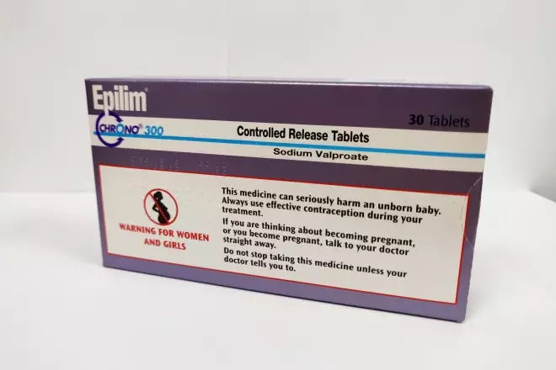
New MHRA Valproate Regulations
31st January 2024
Mo Abdelkafi – Medication Safety Officer

Slide 2


MHRA / NPSA Valproate alert
  Background and safety concerns
  The MHRA regulations 31st January 2024
What are we doing in Powys?
Comments and questions?
Today’s
Agenda

Slide 3
Children exposed to valproate in utero have a very high risk for congenital malformations and neurodevelopmental disorders.
2018 - MHRA aimed to control this risk by ensuring valproate was only used when no other options were available in women of childbearing potential, and in accordance with the Pregnancy Prevention Programme (PPP).
Despite controls valproate remains an issue, thus MHRA Issued new regulatory measure.
Background

Slide 4
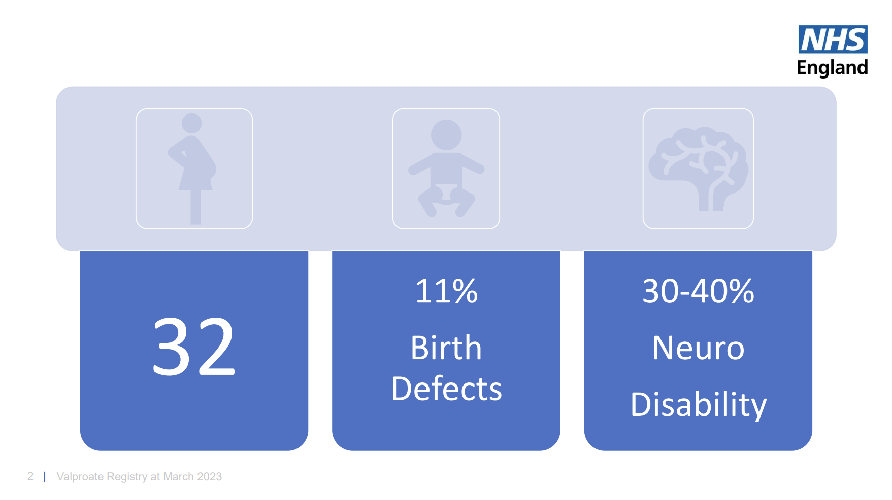
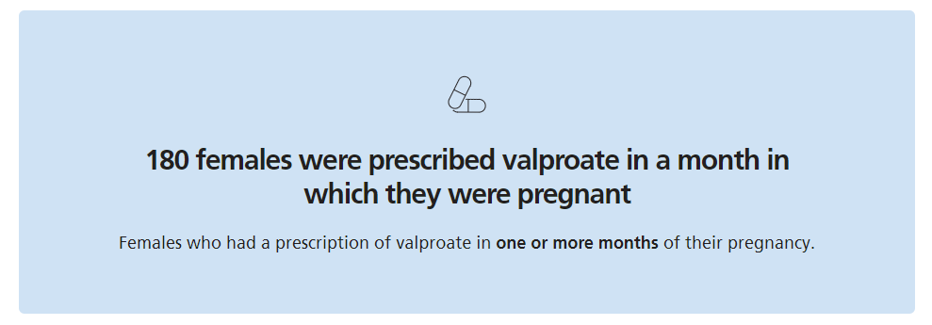

Slide 5
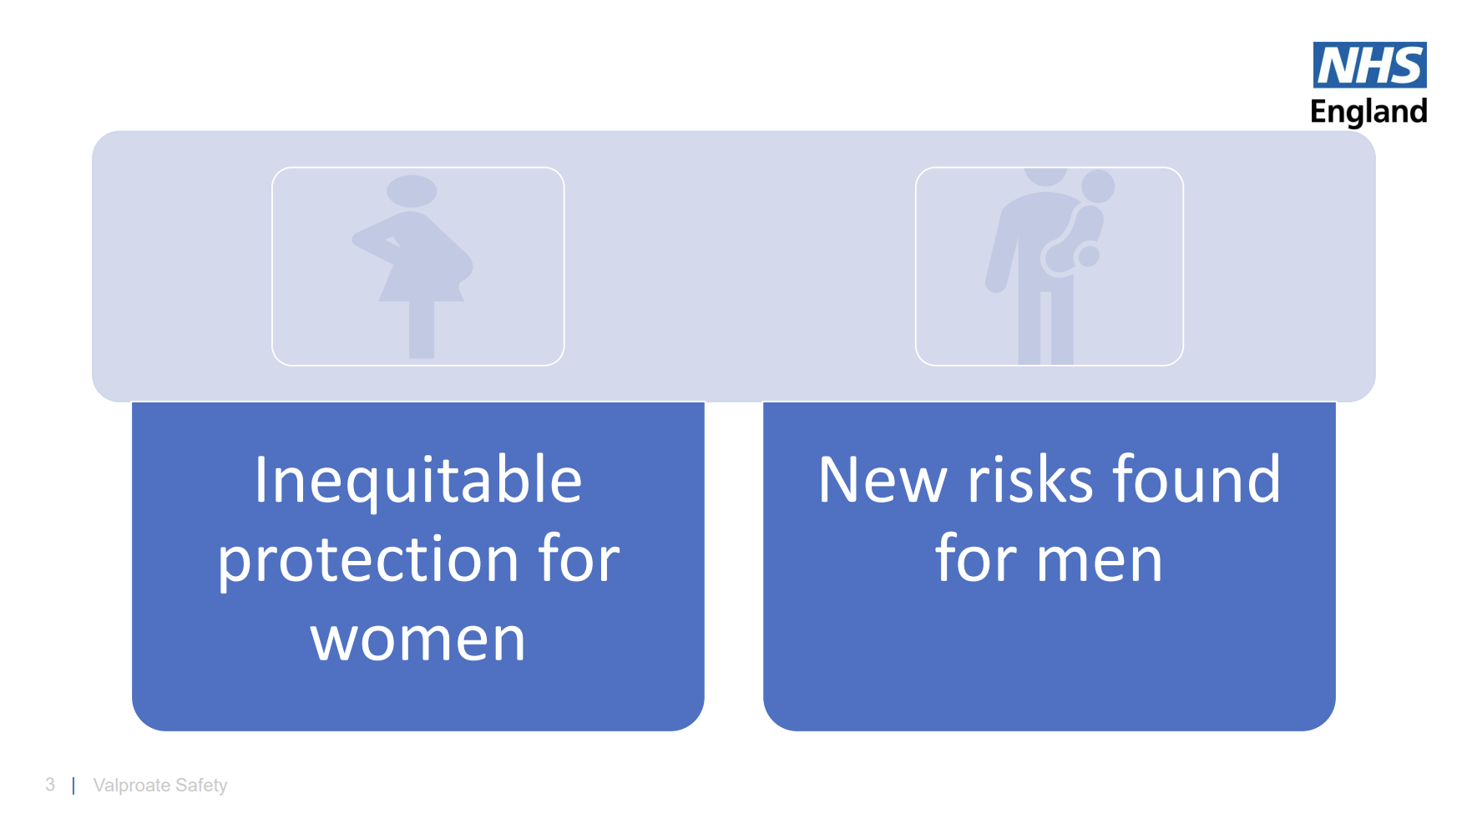

Slide 6
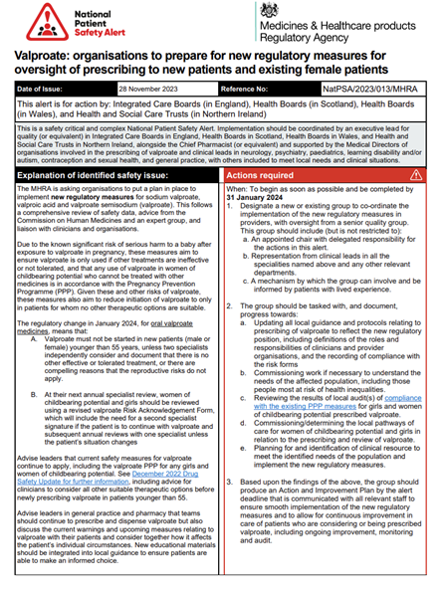
New MHRA
Regulations
31st January 2024

Slide 7
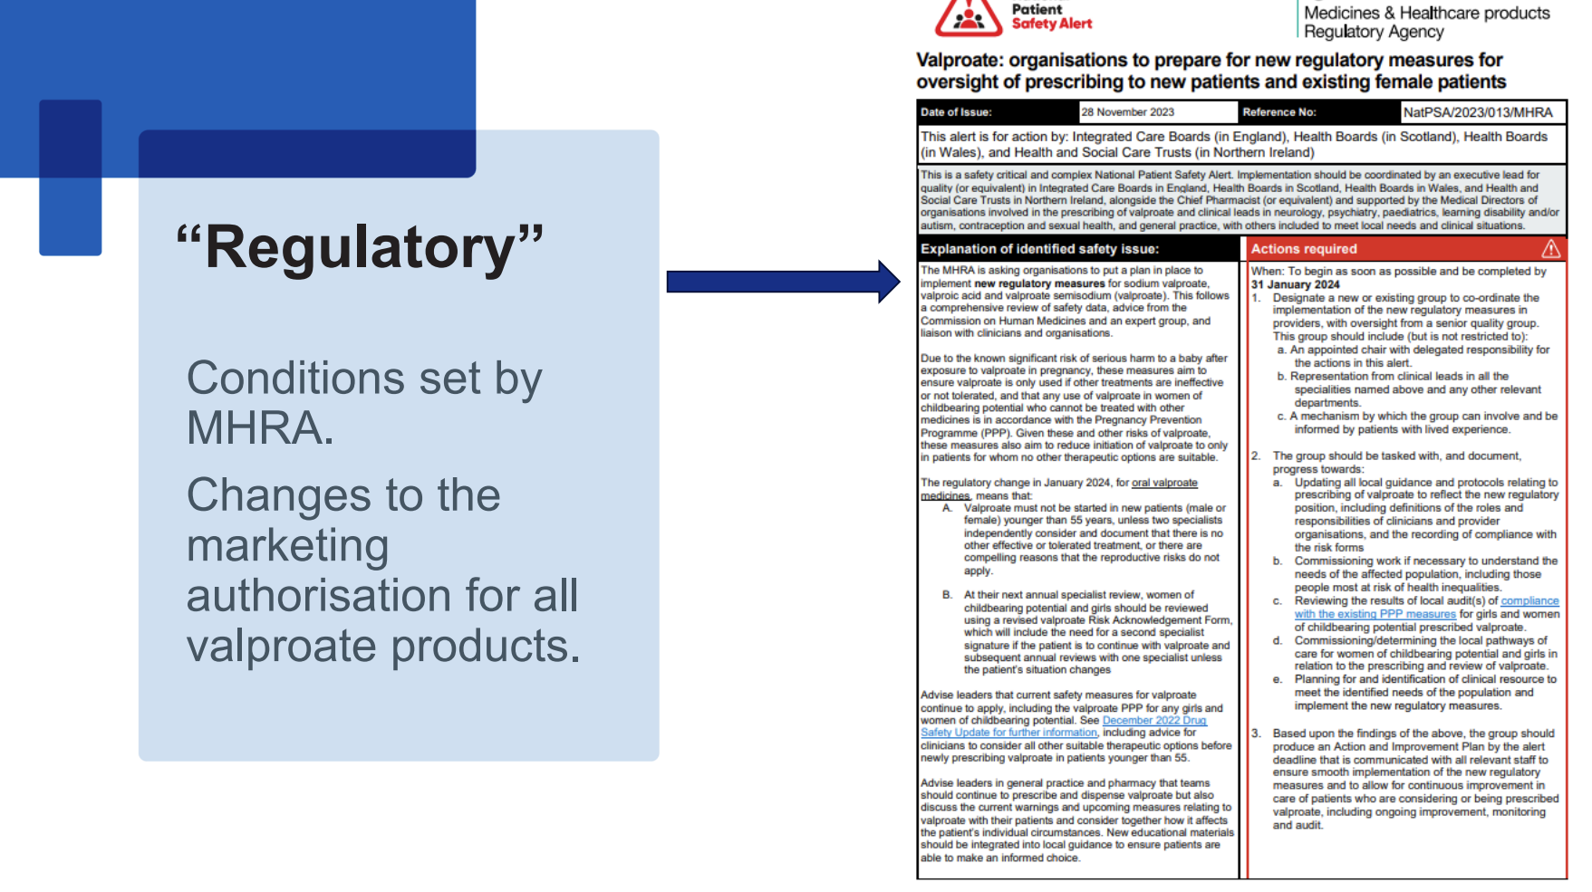

Slide 8
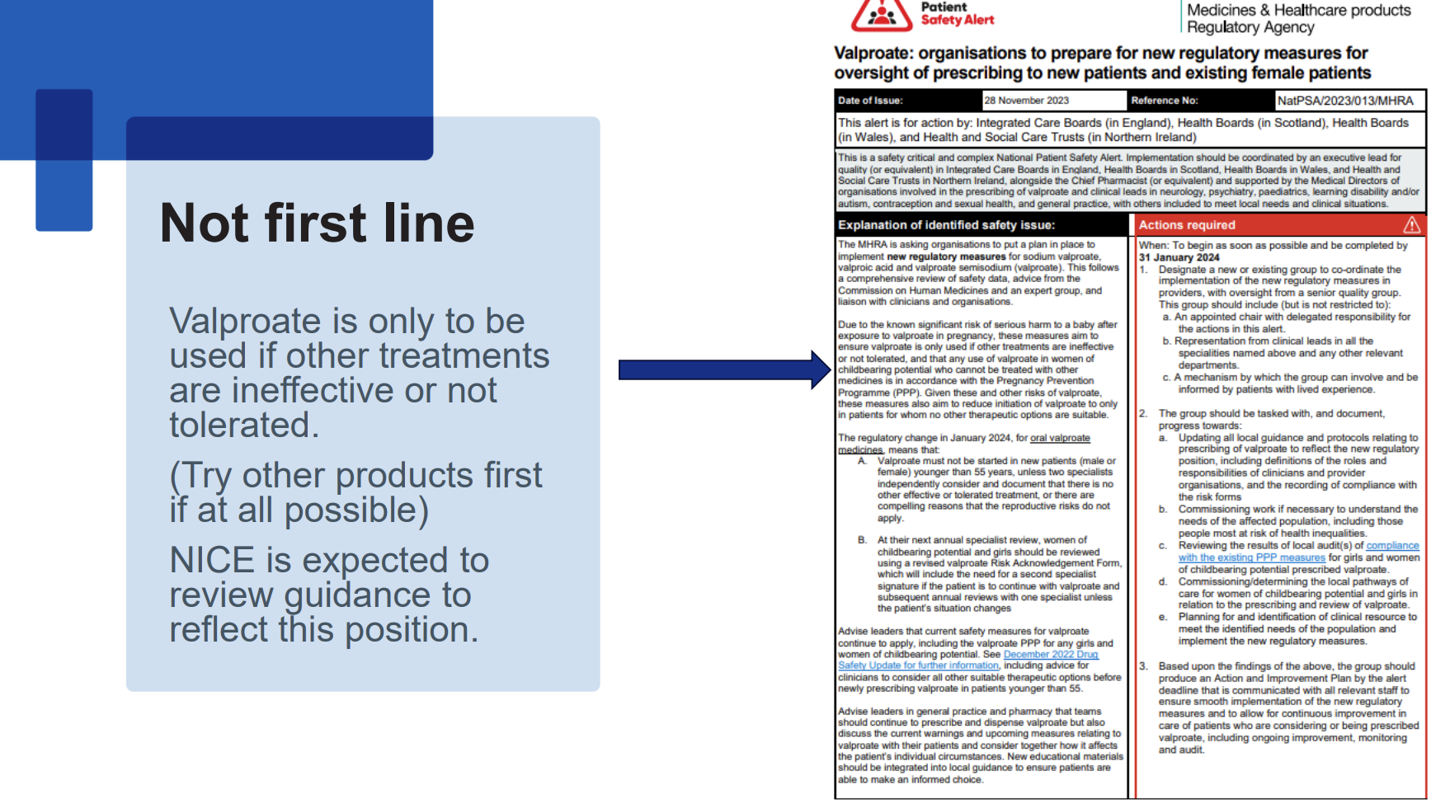

Slide 9
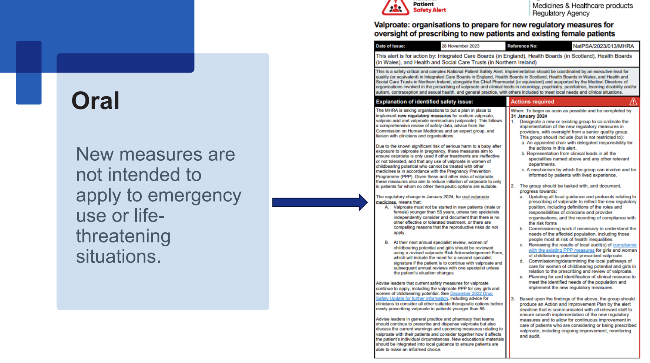

Slide 10
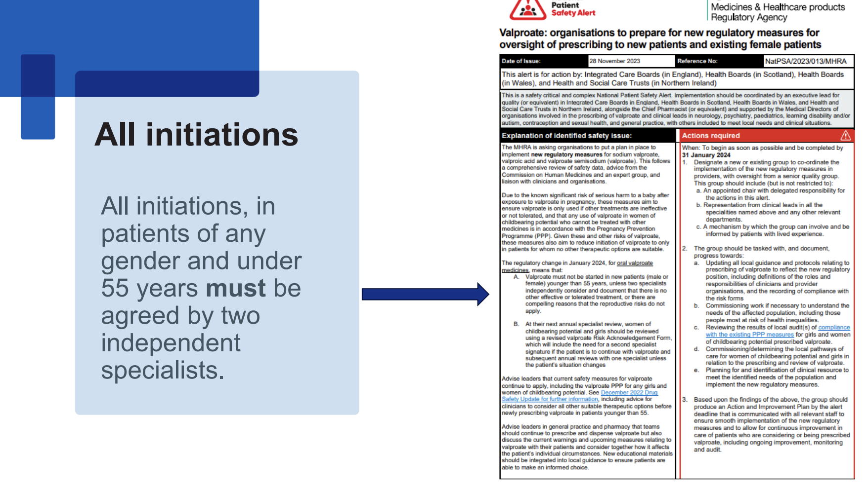

Slide 11
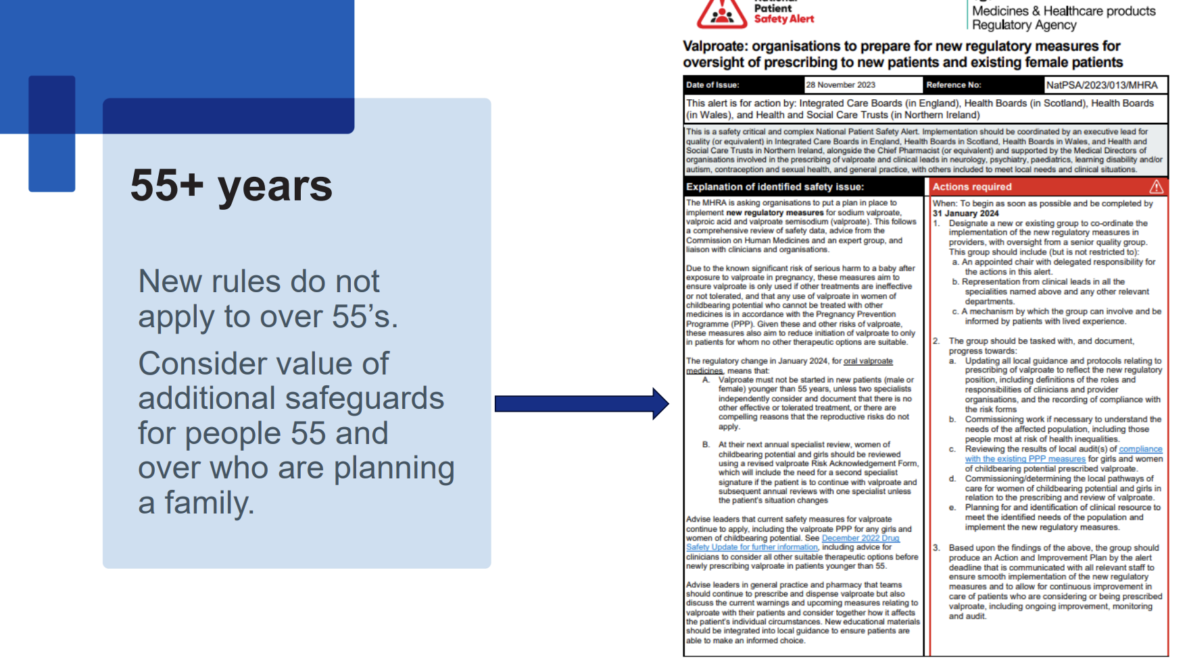

Slide 12
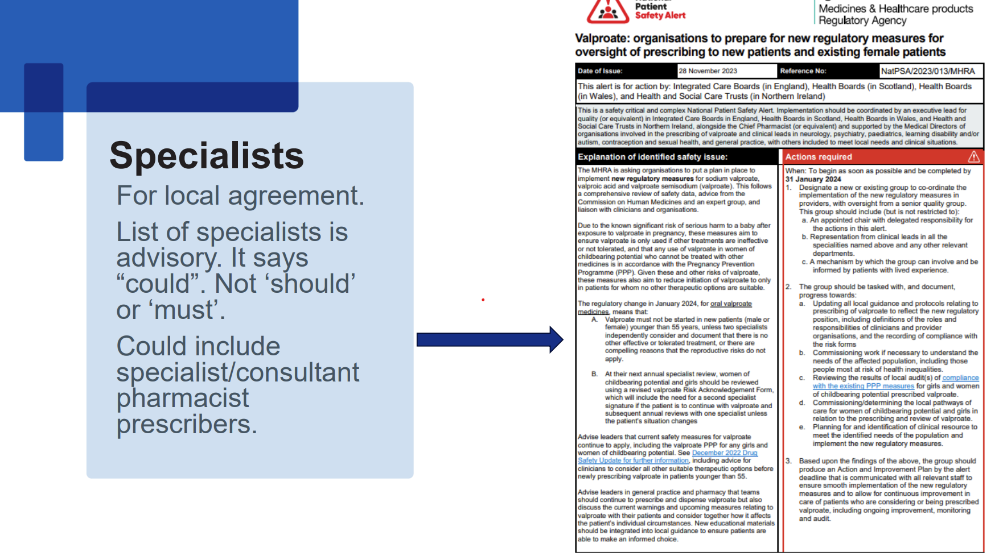

Slide 13
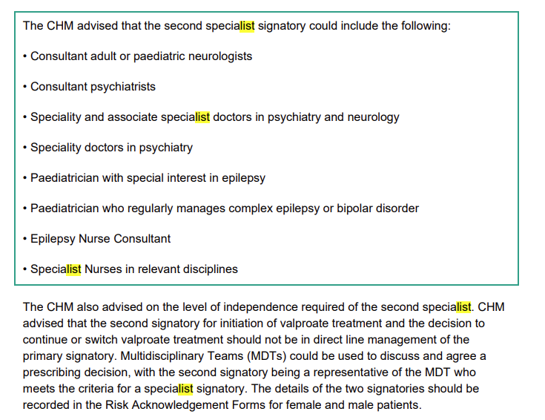

Slide 14
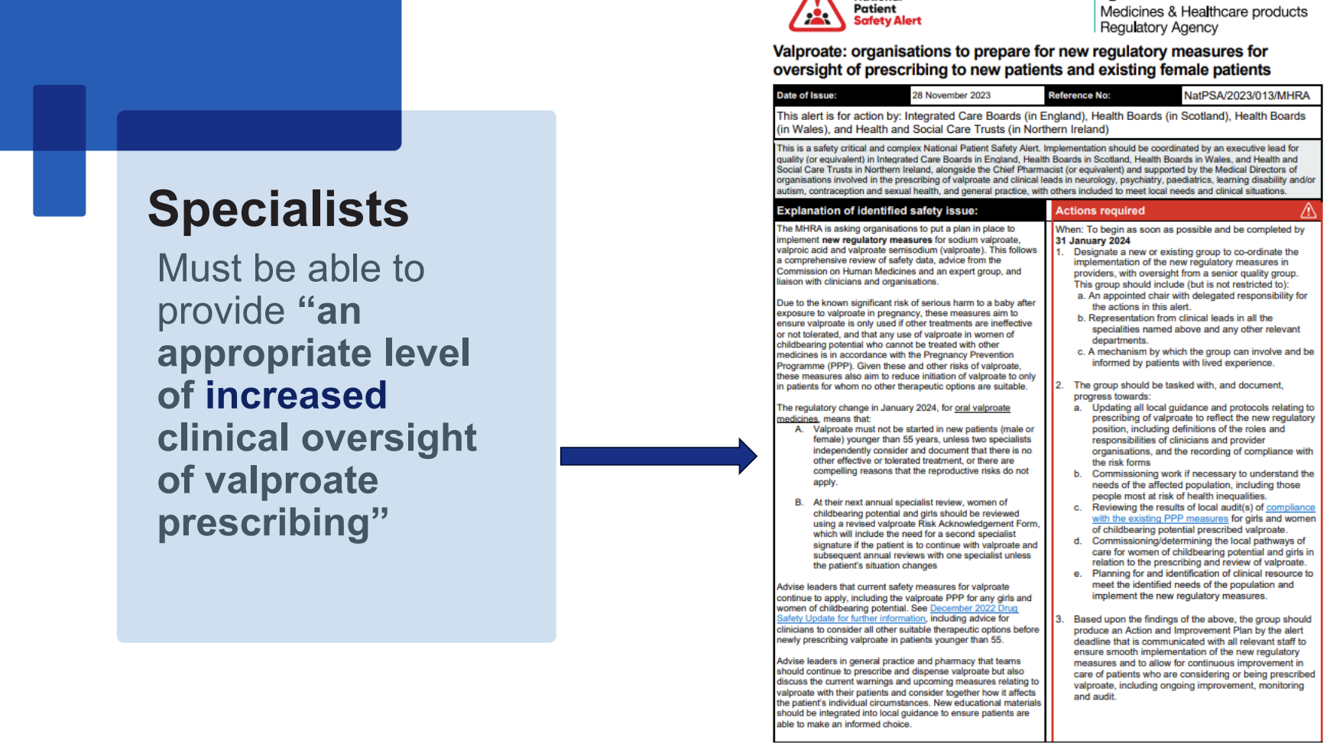

Slide 15
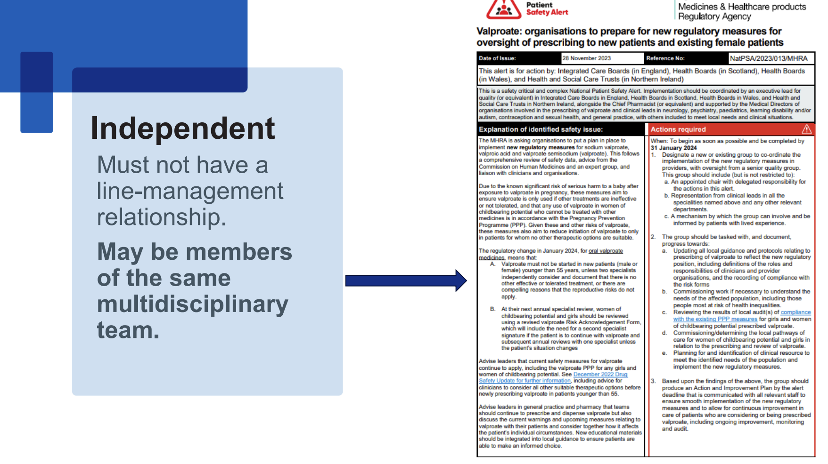

Slide 16
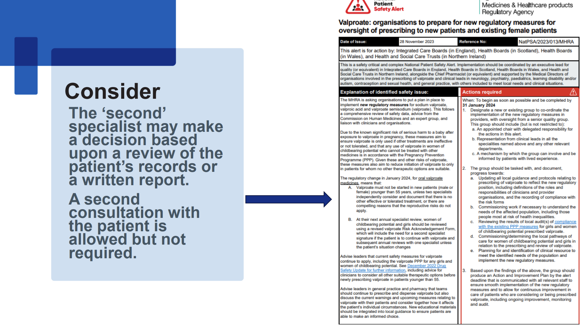

Slide 17
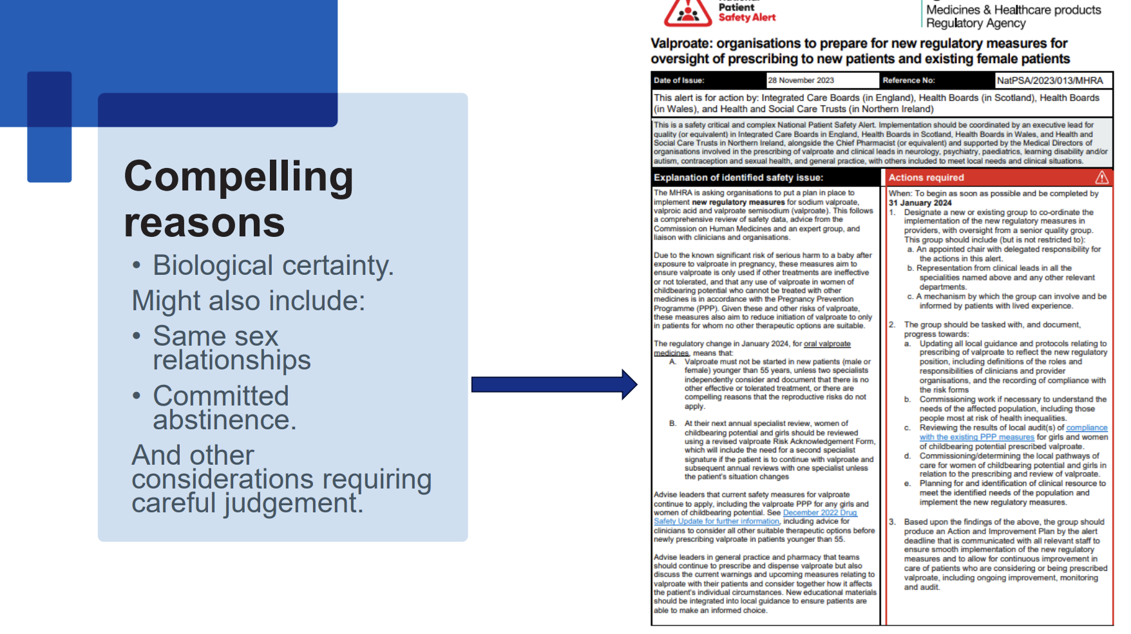

Slide 18
~170 females under 55years receiving valproate.
30 don’t have PPP in place and no recent review with a specialist. (‘Make-safe’ instructions provided to GPs)
7 deemed high risk and have been referred for urgent specialist review.
One female has had 3 pregnancies while on valproate.
Powys Data 2024

Slide 19
Established PTHB Valproate Oversight Committee
Scoped valproate use and compliance in Powys
PTHB Action and improvement Plan
Engaging with all stakeholders
New Valproate Web Page – with all relevant resources
Working on a Powys Valproate Policy
Awaiting NHS-wide Shared Care Agreement
What are we doing?
&
What’s next?

Slide 20

End of presentation
Any questions or comment?
All resources will be shared
Please direct any valproate related questions to:
  Powys.MSO@wales.nhs.uk

