Slide 1

Storage and Handling of Refrigerated Medicines and Vaccines
Emily Guerin
Senior Medicines Management Pharmacy Technician
Medicines Management Team
PTHB

Slide 2
Learning Outcomes
Describe the cold chain and the importance of its maintenance
To manage breakdowns in the cold chain, who to inform and what action to take.
To follow correct procedures for storage and handling of medications and vaccines requiring refrigerated storage

Slide 3
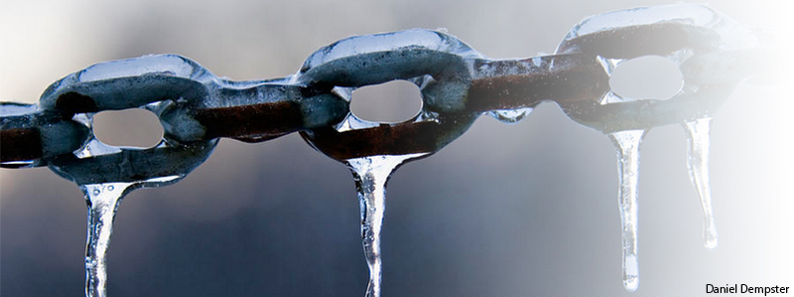
Cold Chain
What is the cold chain?

Slide 4
Cold Chain
The cold chain can be defined as:
The storage and transport of pharmaceuticals requiring controlled low temperature storage between +2º C to + 8ºC from manufacture until the point of administration to a patient.
Source: Advisory Document Handling & Storage of Vaccines 6th revision February 2013
(Nayda C., Kempe A., Miller N. Keep it Cool: the Vaccine Cold Chain. Guidelines for Immunisation Providers on Maintaining the Cold Chain. Second edition. Commonwealth of Australia 2001)

Slide 5
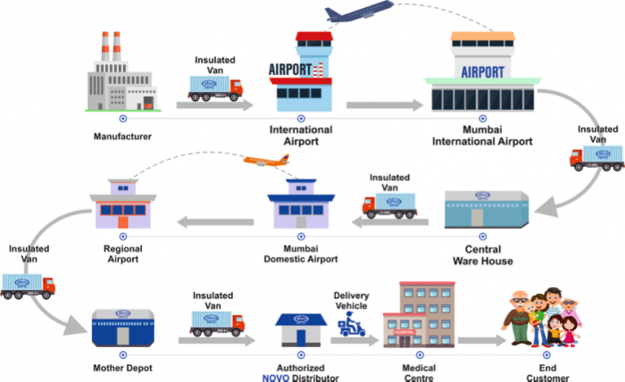
Notes:
Lots of work goes into ensuring the cold chain is maintained throughout the whole process to point of administration

Slide 6
Why is the cold chain important?
To ensure that medicines and vaccines remain potent they must be stored between 2 and 8 degrees. AIM FOR 5 C
If vaccines are not stored correctly, this can reduce the effectiveness of the product, with the potential that the patient will fail to attain satisfactory levels of immunity.
Public Health Wales
Notes:
Vaccines may lose their effectiveness quickly if they become too hot or too cold at any time.

Slide 7
Why is the cold chain important?
Vaccines are biological products, so lose efficacy with time
Where storage conditions are less than optimal, the rate of degradation increases.
This also applies to other medicinal products requiring temperature controlled storage, such as eye drops
Notes:
If they lose potency, they don’t work properly and often we don’t know they haven’t worked until it is too late.
Vaccines naturally biodegrade over time, and storage outside of the recommended temperature range – including during transport – may speed up loss of potency, which cannot be reversed.
This may result in the failure of the vaccine to create the desired immune response and consequently provide poor protection.

Slide 8
Why is the cold chain important?
To ensure maximum benefit from medication and vaccines
Do not cause harm through ineffective medicines or vaccines
Responsibility not to waste scarce NHS resource
Reduce wastage from errors
Notes:
Inappropriate storage and transport results in wastage and unnecessary costs to the NHS.

Slide 9
Responsibilities
Identify a named, appropriately trained, designated person and a deputy
Responsibilities include:
Ensuring cold chain integrity
Managing receipt of vaccines directly into refrigeration
Checking delivery for damages/discrepancies
Maintaining stock information system to keep track of orders, expiry dates and running total of vaccines
Ensuring adequate supplies, Minimising overstock
Daily monitoring and self audits
Temperature excursions

Slide 10

We all have a responsibility
Professional responsibility
If we are using a medicinal product we need to be confident the medicines and vaccines given will be effective.
The person administering has a professional responsibility to act in the best interest of the patient –avoid causing harm
Public Health responsibility
Public confidence in immunisation programmes
Public Health has an organisational responsibility regarding safe and effective vaccination programs

Slide 11
Vaccine Stability
MOST SENSITIVE
Sensitivity to HEAT
BCG
Varicella
MMR
MenC
Hepatitis B
DT and/or aP/IPV/HIB
Sensitivity to COLD
HepB and combination
DTand/or aP/IPV/HIB
Influenza
MenC
*MMR
*Varicella
*BCG
(*Freeze dried)
LEAST SENSITIVE
Notes:
The above sensitivities may give you some idea about the vaccines and their stability outside of the cold chain.
Its important to realise that refrigerated storage doesn’t only protect against heat, but also against excessive cold.
Freezing can be just as damaging to medical products as high temperatures, damaging the container as well as the contents.

Slide 12
Light Sensitive
Sensitive to strong light, sunlight, ultraviolet, fluorescents (neon)
BCG
MMR
Varicella
Meningococcal C Conjugate
Most DTaP containing vaccines
Vaccines should always be stored in their original packaging until point of use to protect them from light
Notes:
It is not just temperature changes, vaccines can be affected by light too, including artificial light.
Therefore vaccines should always be stored in their original packaging.
Also by keeping in original packaging retain information on batch numbers and expiry dates.

Slide 13
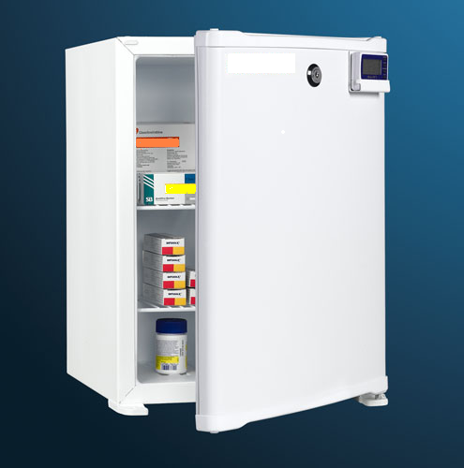
Storage
X No food or medical specimens
X Do not place fridge in direct sunlight or near heat source
X Do not remove products from original boxes until ready to use
X Do not store products in fridge doors or in solid plastic trays/containers within the fridge
X Keep products away from fridge walls and cold air vents
√ Safeguard electricity supply
√ No more than 50% full
√ Defrost/calibrate fridge regularly
√ Ensure back up facilities are available in the event of fridge failing
√ Secure fridge
√ Monitor and record Max/min temperatures daily, then reset
√Keep door closed
Picture taken from www.medisave.co.uk
Notes:
A Mesh basket can be used so that air can circulate – don’t get damp e.t.c This is also helpful to group the vaccine by type.
Treat as any other medicine – with addition of need for closely monitored cold storage.
All vaccines are POMs so they must be locked, or in a locked room do not leave unattended at outlying clinics.
Domestic fridges must not be used – no food drink or clinical specimens.
Defrosting requires an alternative fridge/cool box plus monitoring -don’t return medicines or vaccines to the fridge until temperature is back within range.
Records of regular servicing, defrosting and cleaning should be kept. This can be re orded on the temperature recording sheet.
Opening the refrigerator door should be kept to a minimum in order to maintain a constant temperature. E.g. loading/unloading

Slide 14
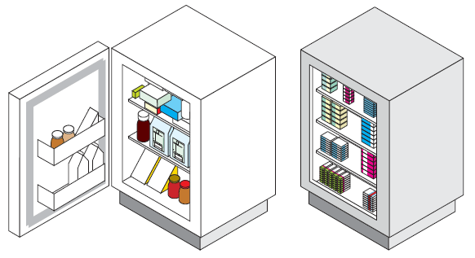
Different Medicines stored incorrectly
No Fridge Temperature being monitored
Door left Open
Food and drinks stored in fridge with medicines/vaccines
Notes:
So from looking at the previous slide is this a good or Bad Fridge? What is wrong with it – Incorrect storage, door left open, no thermometer in place, food, drinks.

Slide 15
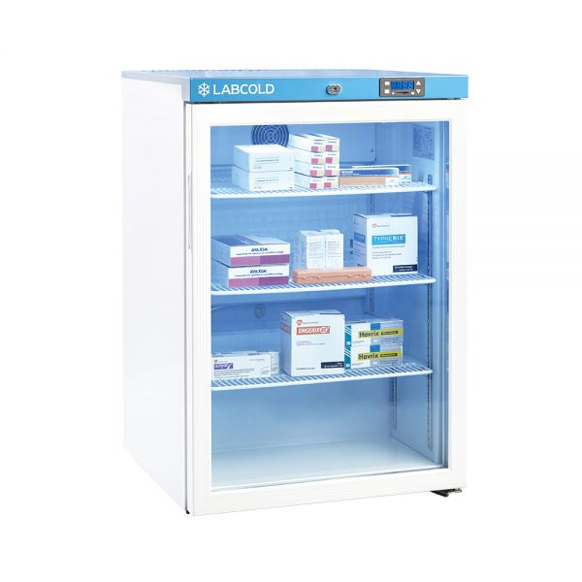
Fridge temperature within range between 2°C and 8°
Fan not blocked allowing air to circulate
Door is closed
Same Medicines are grouped together
No medication/Vaccines stored on the bottom of the fridge
No medication/vaccines touching the sides of the wall
Notes:
This one? Good Fridge – correct storage

Slide 16
Risks of excess stock
Over-Packed
Fridge
Poor Air
Flow
Poor Storage
Rotation
Freezing
Increased Risk
of using out of
date Stock
Sub-Optimal
Vaccines
Increased
Waste
Unprotected
patient
Increased Cost
To Clinic
Notes:
Green book advises surgeries should have no more than 2 – 4 weeks of supply of vaccines at any time. Consider the replacement costs if that fridge were to fail.

Slide 17
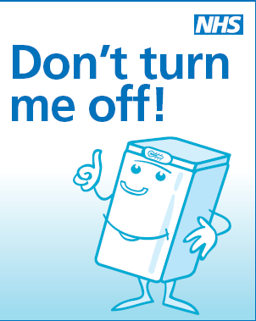
The Vaccine Fridge
Safeguard electricity supply
Place cautionary notices on plugs and sockets
Validated vaccine fridges cost £600 – £1200
Notes:
Electricity – switchless sockets – put stickers on plugs.

Slide 18
Storage
Storage requirements are described in Summary of Product Characteristics (SPCs)
Any use of vaccines that have deviated from recommended storage or transportation conditions:
Are no longer within marketing authorisation (off-license/off-label)
Requires a risk assessment on likely impact of the temperature variation on the vaccine.
Must be reported to the Medicines Management Team to be investigated.

Slide 19
Specific Vaccine Requirements
Ideally use a dedicated vaccine fridge
Place vaccines in clearly labelled plastic mesh baskets
Group vaccines by type(Paediatric, Adult, Adolescent)
Vaccine effectiveness can not be guaranteed unless the vaccine has been stored correctly. Vaccines should be stored in the original packaging, retaining batch numbers and expiry dates.

Slide 20
Temperature Monitoring

Slide 21
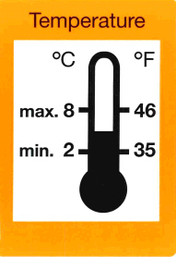
Medicines need to be stored between 2 and 8 degrees
Not 9
Or 10
Or 15…
AIM FOR 5 degrees
Not 1
Or 0
Or -2…
Notes:
The temperature needs to be monitored daily by the responsible individual or an appropriately trained designated person.

Slide 22
Temperature Monitoring
Use max/min thermometer
Probe should be placed in the centre of fridge
Temperature should be recorded at least once a day
Reset daily
Calibrate as recommended
Take immediate action if any temperature is outside recommended range
Even if only by 1ºC
Notes:
Use a max/min thermometer, if the fridge is going to be unattended then consider using a data logger.
Digital thermometers are the most reliable. Can get alarmed max – min thermometers.
Should have at least 2 thermometers

Slide 23
Refrigerator Monitoring Sheet
Department___________________­ Month____________ Year______
FOR ADVICE CONTACT MEDICINES MANAGEMENT ON 01874 712641 OR IF OUT OF HOURS CONTACT NH OR BRONGLAIS PHARMACY
The temperature must be between +2°C and +8°C. If the temperature is outside the recommended range, take action as stated in the disruption of cold chain section of this policy. Remember: Read, Record, Reset, Recheck React.
Date | Time | Temperature Load / Air |  |  | Reset (tick when reset to actual temp) | Any Temp (Actual, Min or Max) outside recommended range? (please circle) | Temperature Rechecked after ONE hour |  |  | Action if any temperature outside normal range (PTO if necessary) | Signature
 |  | Actual | Min | Max |  |  | Actual | Min | Max
1 |  |  |  |  |  | Yes No
2 |  |  |  |  |  | Yes No
3 |  |  |  |  |  | Yes No
4 |  |  |  |  |  | Yes No
5 |  |  |  |  |  | Yes No
6 |  |  |  |  |  | Yes No
7 |  |  |  |  |  | Yes No
8 |  |  |  |  |  | Yes No
9 |  |  |  |  |  | Yes No
10 |  |  |  |  |  | Yes No
11 |  |  |  |  |  | Yes No
12 |  |  |  |  |  | Yes No
13 |  |  |  |  |  | Yes No
14 |  |  |  |  |  | Yes No
15 |  |  |  |  |  | Yes No
16 |  |  |  |  |  | Yes No
17 |  |  |  |  |  | Yes No
Notes:
If OOH contact Switchboard ask for the on-call pharmacist:
For North Powys Bronglais Hospital – 01970 623131
For Mid and South Nevill Hall Hospital 01873 732732
(Contact Details are also on the last slide.)
Go through the monitoring sheet, actual, min and max. Explain if temp out of range, reset and recheck temp again regularly, after an hour

Slide 24
Temperature Monitoring
Observe the Five Rs
Read: daily reading of the thermometer’s maximum, minimum and current temperatures at the same time every day during the working week and during transit
Record: Recording temperatures in a standard way, on a standard form, signing each entry
Reset: resetting the thermometer after each reading, the thermometers should also be reset when temperatures have stabilized after periods of high activity
Recheck Re-check the temperature after ONE hour if out of range temperature then read, record, reset and react.
React: the person making the recording should take action if the temperature falls outside +2˚C to + 8˚C and document this action
Notes:
Reset – after periods of high activity e.g. loading/unloading.

Slide 25
This fridge contains temperature sensitive medicines and vaccines.
The temperature must always be between 2°C and 8°C
Read......Record…...Reset.......Recheck…...React......
Read
Take daily readings of the thermometer’s actual, minimum and maximum
temperatures.
Record
Record temperatures in a standard way on the standard form and sign each entry on the recording sheet
Reset
Reset the thermometer after each reading. Also reset the thermometer when temperatures stabilise after periods of high activity (loading or unloading the fridge).
Recheck
Recheck the temperature after ONE hour if out of range temperature then read, record, reset and react.
React
The person making the recording must take immediate action if any temperature falls out of the range 2°C to 8°C. See disruption of cold chain guidance in Powys Policy Safe & Secure Management of Refrigerated Medicines and Vaccines. The action(s) taken must be documented and should include contacting Medicines Management 01874 712641
If the fridge fails
Keep the door closed and locked if possible. This will keep the contents cool and quarantine them.
DO NOT STORE FOOD DRINK OR CLINICAL SPECIMENS IN THIS FRIDGE
Notes:
Poster available for you to keep close to the fridge – available from the policy or Medicines Management Team.

Slide 26
Temperature Excursions
Cold Chain failure
Break in the cold chain
Temperature out of range
Notes:
All terms used to describe an out of range and all require you to react.
Do not ignore an out of range temperature.

Slide 27
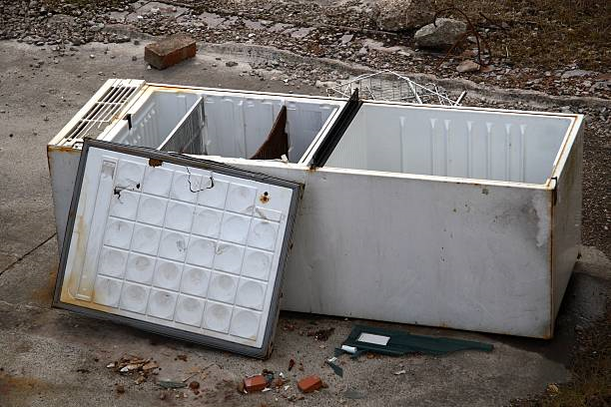
Fridge Failures
TAKE ACTION
Check power
Keep door closed
Check temperature, reset after 1hour
Quarantine stock in alternative fridge
Seek Advice from MMT
Datix
Notes:
Document all actions and record the temperature.
Ensure a Datix is completed.

Slide 28
Temperature Excursion
Any medicine or vaccine that has not been stored at a temperature of 2-8ºC as per its manufacturing recommendations set out in the SPC, is no longer a licensed product.
Responsibility liability rests with administering clinician and/or Health Board.
Contact the Medicines Management Team for advice on medicinal products and vaccines and their stability outside of the cold chain.
DO NOT DESTROY
Notes:
We do have information on some vaccines and their stability outside of the cold chain. This would need to be discussed on an individual basis and its use would be ‘off-label’ / off-license use
Manufacturers may decline responsibility for any subsequent failure of the product if not used in accordance with product licence stated in the SPC.
There are some definite occasions when a vaccine cannot be used
- if the vaccine has been frozen it cannot be used, this causes an increased reactogenicity, loss of potency and can cause hairline cracks in the container leading to contamination.
-If the vaccine has been exposed to non cold chain temperatures more than once. Vaccines generally do not like to be cycled through different temperatures.

Slide 29
What to do if there has been a Cold Chain failure
Where there is any doubt that cold chain has not been maintained, medicines or vaccines should not be used until further advice has been sought from Medicines Management, hospital Pharmacy or the medicine or vaccine manufacturer
Notes:
Bag the medicines/vaccines and quarantine them in alternative cold chain storage.

Slide 30
Post Administration
Treat as Serious Untoward Incident
Seek advice from medical or pharmacy staff to find out if any clinical action needs to be taken.
Inform Line Manager of the incident
Inform IMMFORM
Report using Datix
If a vaccine, suspend all immunisation clinics until resolved
Notes:
If a medicine or vaccine has been given and been subject to a temperature excursion -

Slide 31
OUT OF RANGE TEMPERATURE
Quarantine in alternative cold storage to prevent administration until approved
Clearly mark stock to show it has been subject to a temperature excursion
Reset thermometer & check again in 1 hour
Datix & investigate
Seek advice from manufacturer / MMT
DO NOT IGNORE A TEMPERATURE EXCURSION

Slide 32
DISRUPTION OF COLD CHAIN – MEDICINES & VACCINES form
Any affected medication MUST be quarantined and may only be used following recommendations to do so f rom Medicines Management Team
Unit / Ward / Clinic / Practice: | Member of staff reporting incident: |  | Datix Number: | Date and time of report:
What temperature did the fridge reach during the excursion and for how long? Last recorded temperatures before incident occurred Date and time: min/max/actual: |  | Brief description of the incident (e.g. door left open, power failure)
1 | 2 | 3 | 4 | 5 | 6 | 7 | 8 | 9
Generic and/or Branded Name Of Medicine / Vaccine | Manufacturer name Of Medicine / Vaccine | Batch Number | Expiry Date | Quantity | Confirm it has been quarantined in alternative cold storage (Tick) | Has this medicine/vaccine had a previous temperature excursion? (Yes / No) | For completion by MM Team / Pharmacy List information sources. Describe any reduction in shelf life or restrictions in usage. Record any other relevant information Record the final fate of the product Vaccine wastage logged on IMMFORM Y / N | Loss £ (To be completed by MM team)
Unit / Ward / Clinic / Practice – complete top sections and columns 1 to 7 and fax to 01874 712651 or scan and e-mail to Info.medicinesmanagement.powys@wales.nhs.uk Medicines Management or supplying Pharmacy will document the final fate of the product and inform the Unit / Ward / Clinic / Practice by fax or e-mail.
Notes:
Talk through the disruption of cold chain form.
The MMT require full details including manufacturer in order to deal with the excursion
Once the MMT have responses from Manufacturers we will document this on the form and record any relevant information. The MMT will advise whether a medicine/vaccine should be destroyed, have a reduced expiry or okay to use with no action required.
Once you have this information it is important that you mark the box to say that it has been outside of the cold chain and has been subject to a temperature excursion, add and highlight any reduced expiry dates.

Slide 33
Medicines Management Team
On receiving a disruption of cold chain form the MMT will:
Check a Datix has been completed.
Medicines have been quarantined in alternative cold storage.
Contact the manufacturer’s for advice
Provide you with outcomes e.g. Destroy, reduce expiry, safe to use. If Medicines are safe to use, or expiry reduced, they must be marked clearly to show it has been subject to a temperature excursion
Notes:
GP Practice only – vaccine wastage, to report waste on IMMFORM

Slide 34
Transporting vaccines
Use a validated vaccine porter and cool packs from recognised medical supply company
Monitor maximum/minimum temperature, recording at regular intervals
Vaccines should be wrapped in bubble wrap or similar insulation material to prevent direct contact with cool packs
Use insulating material to fill any spaces within the cool box
Only take enough vaccine for particular session and minimise exposure of the vaccines to room temperatures

Slide 35
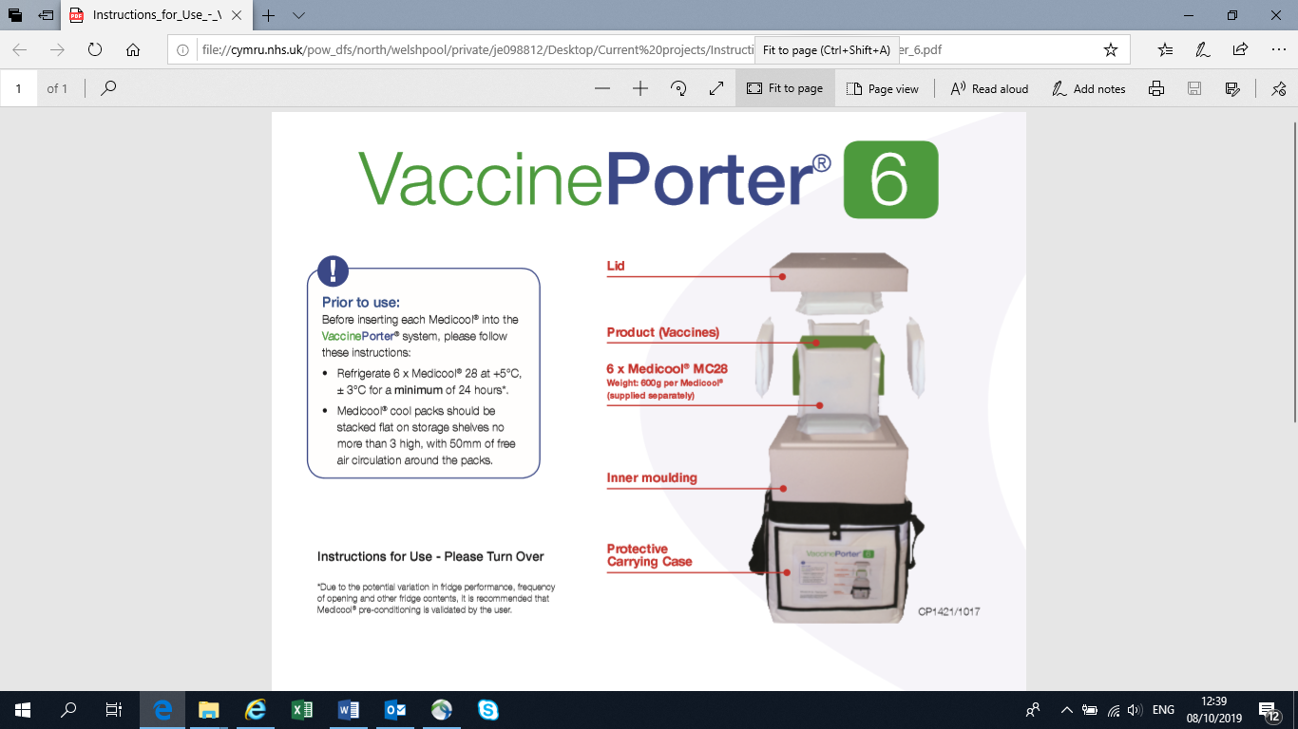
Notes:
Prior to use cool packs must be refrigerated for a min of 24hours before use.
6 – 1 base, 4 sides, 1 top.
Bubble wrap to put around vaccines to protect or insulated material to fill in the gaps.
Keep opening and closing to a min.
Data logger / thermometer to track the temperature

Slide 36
If a vaccine is unused
If a vaccine is removed from the fridge with the intention of administration but is unused, providing that the cold chain has been maintained, (up to a maximum of the validated time period for the cool box used) then it can be returned to the fridge
Notes:
Following these conditions on next slide

Slide 37
If a vaccine is unused
Clearly marked with the date and time of its return, the length of time it was out of the fridge and kept in a validated cool box and a black cross on all sides of the box.
Any vaccine returned to the fridge should be placed at the front of the fridge to ensure that it is used first at the next session.
Once the vaccine has been removed from the fridge for a second time, if it remains unused after being removed on this occasion it should be discarded.

Slide 38
Disposal of refrigerated medicines and vaccines

Slide 39
Disposal
For vaccines that have been reconstituted for immunisation, at the end of an immunisation session any remaining reconstituted vaccine must be placed in a sharps bin for incineration.
Vaccines that are time expired, no longer suitable for use, used or partially used vaccine ampoules or vials should be disposed of in a sharps bin
For disposal of unusable medicinal products, discard according to general disposal arrangements. Refer to Powys sustainable waste management procedure PTHB | FTP 002 Sustainable Waste Management Procedure and/or Powys medicines policy PTHB | MMP 001 Powys Medicines Policy

Slide 40
Audits
Regular self audit of current practice:
Daily temperature monitoring.
Each week check the contents of the fridge at least once.
Each month vaccine stock should be audited and recorded.
Every three months, audit records of stock and temperature management
Compliance with policy will be audited at Medicines Management audits of wards / departments.

Slide 41
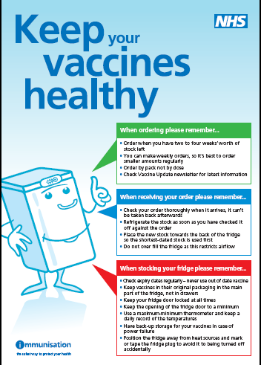
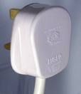
Useful resources
Chapter 3&4 Green Book: “Storage, distribution and disposal of vaccines” and “Immunisation Procedures”
Poster and plug stickers available to order from DH publications orderline (www.dh.gov.uk)
CDC Vaccine Storage and Handling Toolkit http://www2a.cdc.gov/vaccines/ed/shtoolkit/
WHO. Temperature sensitivity of vaccines. August 2006. http://www.who.int/vaccines-documents/DocsPDF06/847.pdf

Slide 42
Contacts
Medicines Management Team, PTHB Monday to Friday, 9am – 5pm
01874 712641
On call Pharmacists OOH / weekends
Nevill Hall Hospital 01873 732732
Bronglais Hospital 01970 623131

